Slide 1
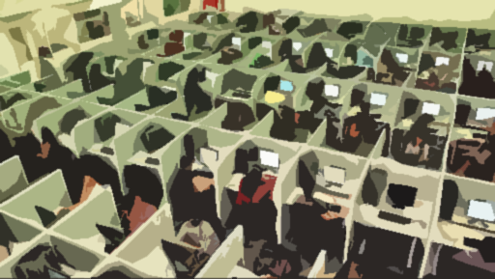
What stops us from working?
(Ten Years Later)
A brief inquiry into disincentives to work: Voices of people with lived experience of disabilities and poverty
John Stapleton
With Yvonne Yuan
Open Policy Ontario
For the Social Assistance Coalition of Scarborough (SACS)

Slide 2

“The rational person would say ‘what’s the point of working?’ The majority of people work to get ahead, not to get behind.”
– Sharon, consumer/survivor, on working while receiving ODSP

Slide 3

“The reluctance/refusal of so many employers to hire/promote workers with any kind of disability, whether on social assistance, WSIB (Workers’ Compensation), and just disabled by whatever cause… is a major issue that needs emphasis.
I have previously recommended that the Prime Minister (at the federal level) or the provincial Premiers should call together a selection of business, labour and disability groups to try to forge a new commitment to employing persons with disabilities”
–John Rae

Slide 4
introduction
Some background…

Slide 5
Ten Years ago…
In a report written in 2011, we came to the conclusion that the reasons that very few Ontario Disability Support Plan recipients have earnings were:
  “… A needlessly onerous system of reporting and reconciliation;
  Negative interactions between ODSP and other programs; and
  Insufficient supports for leaving ODSP.”

Slide 6
Almost nothing has changed since that report was written…
The purpose of the present paper is to explain why it is so difficult. We propose a general theory as to why there is such little success.
At the end of our report, we restate recommendations offered in the 2011 report, appealing for a more thorough consideration and, hopefully, implementation of most of the proposed recommendations.
With the relentless push to nudge social assistance recipients into employment by governments, regardless of the political party in power, the results don’t look all that promising.
So why is it so hard to go to work or get back to work once you go on social assistance?

Slide 7
A general Theory
why Working is so difficult

Slide 8
A General Theory
Our general theory has several component parts that emanate from new and older thinking, some of which postdate the 2011 paper.

Slide 9
A general Theory
The component parts of the theory are:
Infrastructural/Systemic Deficits | Behavioural Obstacles
1. Destitution-based social programs . | 4. The psychology of scarcity.
2. Multiple confiscation machines at work. | 5. The ‘sludge’ theory in behavioral economics.
3. Misunderstandings in mainstream assumptions concerning work among low-income people with disabilities. | 6. A Pandora’s Box: what happens to an overfull, overhead closet shelf?

Slide 10
Infrastructural/Systemic Deficits
Destitution and Misunderstandings

Slide 11
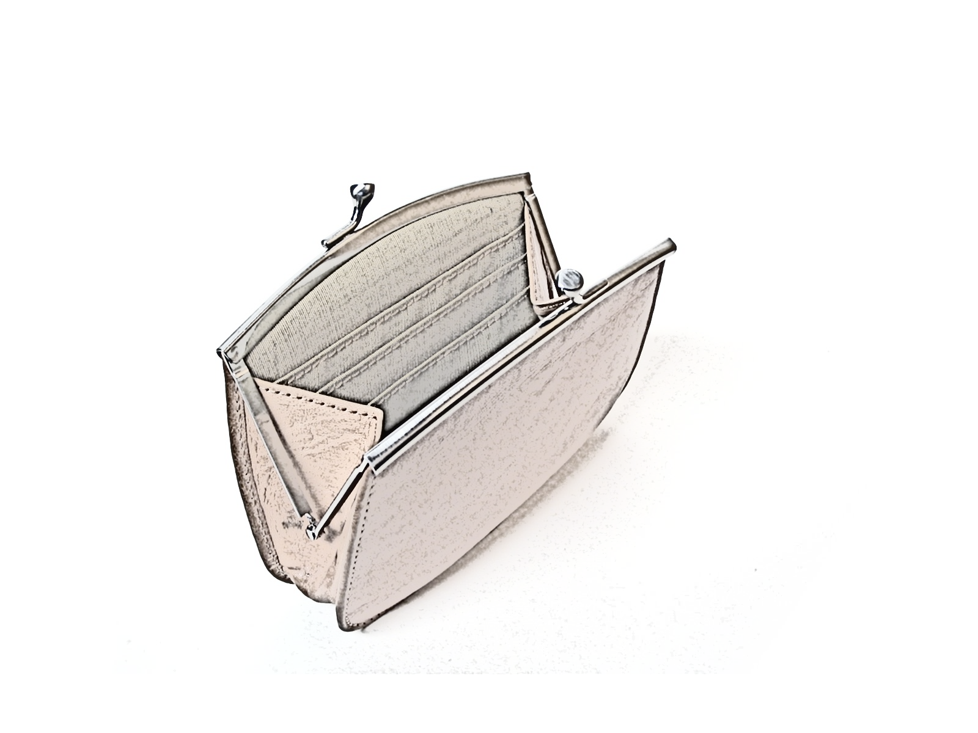
1. Destitution-based programs
…that mitigate against success

Slide 12
The Destitution model
Social assistance programs are based on a destitution model where what is designed as a floor income has the unintended consequence of acting as a ceiling.
Getting back on one’s feet and ‘bootstrapping’ presuppose that once you start to do better (earning money, saving money, reducing expenses, getting help from friends and family, getting a better job), you will start to be better off.
This is often not true in social assistance as the program claws back earnings, has asset limits that reduce savings, pays lower rates when shelter costs are reduced, and limits the amounts one can receive from friends and family.

Slide 13
Destitution model (Cont.)
These programs also force recipients into bad decisions by：
  making it harder for work to pay off,
  making it impossible to save significant amounts,
  punishing decisions to reduce expenses,
  placing limits on how much friends can help and
  forcing people to take whatever job is available regardless of its value.
In other words, success entails making a leap as opposed to progressing.

Slide 14
“I had to report income all the time and was audited suspiciously… I always had to fight, was afraid of being cut off and if within the limits; I was worried if I got more income than ODSP, what is going to happen to my ODSP cheque, to my dental benefits, MSN (Mandatory Special Necessities), special housing, I was living in a state of anxiety and fear, in a poverty trap, the system was built to keep you there. I was making my calculations and tried to figure out what would need to earn to live not on ODSP to get off ODSP – $55-65,000 – a huge barrier to re-enter the workforce – need to upgrade my skills. Better for OW – they can get the supplement, supports and training. There is no help with finding jobs on ODSP.”
– Anonymous #1 (59)
“The system was built to keep you there.”

Slide 15

2. The effects of ‘multiple confiscation machines’ at work
…where they cancel each other Out

Slide 16
How can we improve income security in a post-CERB world? First policy Response, Ryerson University, August 27, 2020
There are only three income security programs that promote work as part of their mandate and allow work as part of general eligibility:
  social assistance,
  EI working on claim, and
  the Canada Workers Benefit.
They don’t work together. Each has a different pedigree. EI Working While on Claim is a taxable benefit. Social assistance is not taxed. The CWB is a refundable tax credit. Together, they resemble the old game of Rock Paper Scissors – they like cancelling out each other.

Slide 17
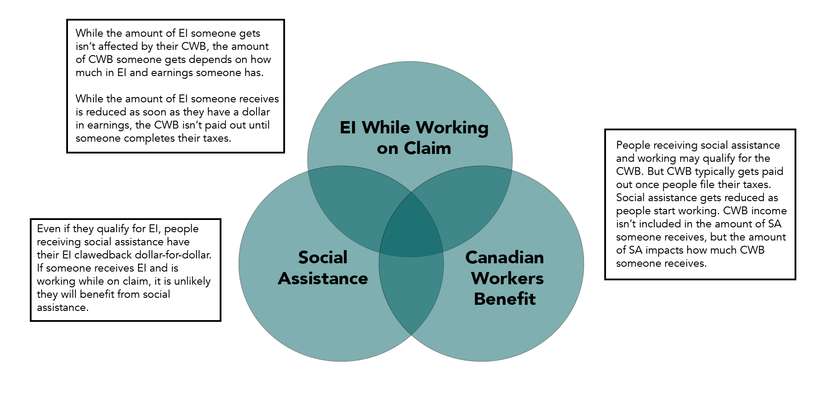
All three programs could work together rather than cannibalizing each other but no one has ever asked them to.

Slide 18
“I was always scared to ask my ODSP worker about employment opportunities as I didn’t want to lose my disability benefits. My understanding is that if I do work while receiving ODSP, I may lose my benefits.”
– Anonymous #2 (62)
“My understanding is that if I do work while receiving ODSP, I may lose my benefits.”

Slide 19
3. Mainstream assumptions
… concerning how the world works apply to low-income people with disabilities

Slide 20
Mainstream assumptions
The short answer is that the accommodations that work for middle class people simply do not work for people who are poor and especially those who are on social assistance with disabilities.

Slide 21
Bee Lee Soh & John Stapleton, Voice of Experience, Metcalf Foundation, 2019, p.24
“Governments…may not know the minimum cost of secure accommodation and they may not know that libraries and community hubs restrict access to … online computer equipment. They may not realize that a low-income person may not have … a bank account or access to retail credit through a credit card.
The everyday items and conveniences that most of us take for granted as part of our daily lives, like smart phones and credit cards, are accoutrements that we would never dream of doing without. We also have little idea of the problems we would face if we did not have them. For example, few would contemplate that not having a credit card could result in us having no place to stay on a winter’s night. ”

Slide 22
“People with disabilities have other stresses when it comes to working. For instance, we are most likely to only work part-time but this puts us at a disadvantage in other ways. For example, because I am part-time the employer can schedule me however he sees fit, including whether to schedule me at all. This means I may not get shifts. This rule likely impacts people with disabilities more than other people because most of us can only part time. It is hard to plan our life around inconsistent employment, schedules and pay.
– AP (39)
“[W]e are most likely to only work part-time but this puts us at a disadvantage in other ways”

Slide 23
Behavioural Obstacles
Scarcity, Sludge, and a Pandora’s Box

Slide 24

4. The psychology of scarcity
Why having so little means so much

Slide 25
Alok Jha: Poverty saps mental capacity to deal with complex tasks, say scientists. - The Guardian, August 29, 2013
“Being poor requires so much mental energy
This is the psychology of scarcity…people's minds are less efficient when they feel they lack something — whether it is money, time, calories or even companionship.
This scarcity mindset consumes…"mental bandwidth" — brainpower that would otherwise go to less pressing concerns, planning ahead and problem-solving.
This deprivation can lead to a life absorbed by preoccupations that impose ongoing cognitive deficits and reinforce self-defeating actions”

Slide 26
Amy Novotney: The psychology of scarcity. American Psychological Association, February 2014, Vol 45, No.2
“We found that when people were rich with time they were very judicious, needed it less, and only very occasionally took a loan.
But when they were time-poor … sophisticated Princeton students grabbed these available loans to try and do well in the game and ended up making less money than the time-poor students who weren't given the option to borrow. These students made the same mistakes that we observed among poor people.”

Slide 27
“It would be great if people with disabilities did not have to stress about money the way we do now. Costs to us have increased during Covid.
I live in a rooming house and have had to pay for disinfectant to help ensure I do not get Covid. I buy this to protect my health, but ODSP does not provide enough money to help me take care of myself.
At the end of the day ‘employment supports’ are supposed to be positive, not negative. It’s in the name. Those of us with disabilities already have so much stress just to work, because we need that money for food or transportation. I feel that ODSP should not be adding to our struggle. ”
– AP (39)
“Those of us with disabilities already have so much stress just to work.”

Slide 28
5. The ‘sludge’ theory in behavioral economics
Making things difficult

Slide 29
‘Sludge’: Richard Thaler
Sludge theory is the opposite of the ‘nudge’ theory in behavioural economics.
Sludge is where actions towards achieving a certain goal are made more difficult through barriers to participation being put in place.
Going back to work while on social assistance is notoriously difficult and unrewarding – a good example of ‘sludge’.

Slide 30
‘Sludge’ (Cont.)
With social assistance, it starts with conditionality where one is asked to have a plan leading to work.
Once work begins, a complex, difficult and unresponsive system of monthly reporting and reconciliation begins with failure to meet all requirements routinely resulting in ineligibility where all benefits are suspended or cancelled (these rules have recently changed).
In behavioural economics, ‘loss aversion’ is much more important than ‘gain attraction’. The administration of social assistance emphasizes loss of benefits much more than earning or gaining independence. It is replete with sludge.

Slide 31
https://www.behavioraleconomics.com/resources/mini-encyclopedia-of-be/sludge/
“This practice (sludge-making) has two defining characteristics: “Friction and bad intentions.” Instead of making choices easier, as nudge does, sludge often makes them hard. And, crucially, sludge is not in the best interests of those being nudged (sludged?).
Corporations are notorious practitioners of sludge—just think of every newsletter and subscription that’s oh-so-easy to sign up for but incredibly difficult to cancel. But governments, too, increasingly show signs of sludge. ”

Slide 32
[Cont.]
“I may stop receiving benefits soon - I have requested to NOT redo a years’ worth of reporting because this will honestly send me into crisis. The deadline they provided me is nearing and I have not heard back, nor can I get a hold of any managers to discuss the issue. I spent months putting together a years’ worth of reporting and organized it very well, and I will not redo it to be “more organized". It is my caseworker's job to do the work of sifting through the immense amount of documents she has requested from me.
This has been a point of conflict for us, but I have no interest in doing more work to make her job easier… she is being paid much more than me to do this work, and I have done everything in my capacity to fulfill my reporting requirements adequately.
The difficulty of the reporting process and discretionary practices of my caseworker make me feel like giving up and leaving ODSP. I truly believe this is their intention - to make it so hard that we give up and leave.”
– WJK (26)
“…[They] make it so hard that we give up and leave.”

Slide 33

6. A Pandora’s Box
What happens to an overfull overhead shelf?

Slide 34
A Pandora’s Box
When we try to explain to people who are not poor what it is like to try to start to work when you are receiving social assistance, they ask “Why don’t they work? Why don’t they bootstrap themselves up?
We try to explain the problem in terms of an overstuffed overhead closet shelf.
We have all been there. We start with some Knick Knacks, then a scarf, some mittens, some gloves, then a box of something and a bag of something else. Finally, the closet shelf is jammed full. Then we need something from off the shelf.

Slide 35
A Pandora’s Box – the overhead shelf
When we try to carefully (gingerly) pull something down from the shelf, what happens?
Most of the contents of the shelf come crashing down on your head and you spend the next period of time finding the desired item and sorting through the bags, boxes and items before you put them back on the shelf.

Slide 36
this is what happens to people receiving social assistance
Their allowances go down.
Their rents go up (if they live in subsidized housing)
Their reporting requirements become onerous and many get suspended from assistance even when they get the paperwork in on time
They get saddled with recurring overpayments
They live in a ‘boom and bust’ world as their income goes up and down like a yoyo

Slide 37
this is what happens to people receiving social assistance (Cont.)
They are expected to have phones (that they don’t have)
They are expected to have access to retail credit
It is assumed they have access to broadband
It is assumed they can pay for a transit pass; and
It is assumed that they can pay for other work expenses.

Slide 38
“[I worked in] clerical work, reception, office admin, call centre work, cleaning…[I have] worked on and off while on ODSP… [I] left different jobs due to mental health issues, stress and mental health caused her to need to take a break.
Main stress from ODSP was being cut off due to reporting requirements, but it never made [me] quit a job…
The main issue was being cut off frequently, including 7 months in a row. The rules didn’t stop me from working, but I don’t want to work more than the absolute minimum. Right now, I work 16 hours a week. I could work more hours when it’s busy, but it’s a commission job and I make $11-12 an hour before the claw back, and after it would be $6 an hour so it’s not worth my while.”
– Anonymous #3 - ODSP RECIPIENT (50)
“The main issue was being cut off frequently.”

Slide 39
Conclusion and recommendations
and principles

Slide 40
Conclusion
People who live on social assistance are living in a world of destitution, scarcity, sludge, confiscation, false assumptions and overstuffed closet shelves. Social assistance and work don’t mix well. We can have nothing but admiration for the very distinct minority who manage the world of work while in receipt of social assistance.
It is not difficult to make recommendations that will make a meaningful difference and help them work while on assistance.
We developed 6 principles in eliminating the barriers to work for people receiving welfare benefits.

Slide 41
6 Principles
1. Stop Destitution.
2. Stop multiple confiscation among programs.
3. Stop applying mainstream assumptions about how people live and work to low-income people and especially those on social assistance.
4. Increase Client bandwidth while reducing scarcity.
5. Remove Sludge.
6. Help reorganize the overhead closet.

Slide 42
1. Stop Destitution
Abandon the destitution-based model for social assistance.
Allow clients to keep more of the money they earn before their allowances go down.
Allow family and friends to help out without restrictions.
Allow people to save and keep a meaningful cushion of money, allow clients to reduce costs without penalty.

Slide 43
2. Stop multiple confiscation among programs
Our request is that Employment and Social Development Canada, the federal finance department and provincial/territorial ministers mandate their officials to work together to get these programs to stop pummeling each other.

Slide 44
3. Stop applying Unrealistic mainstream assumptions
Engaging people with lived experience is a new undertaking for governments.
New processes are needed to address both unfactored considerations as well as assumptions made about the costs of participation for low-income people.
  It’s important to stop and consider these costs — financial and personal — as successful inclusion is dependent on these costs being met.
Bee Lee Soh & John Stapleton, Voice of Experience – op. cit. Metcalf Foundation , 2019, p.24

Slide 45
4. Increase Client bandwidth while reducing scarcity
“But when you give them a very complicated form or demand that they be somewhere exactly on time three days in a row, you're imposing a massive bandwidth tax. Instead of taxing them money, you're taxing them bandwidth, which is also something they don't have enough of. So, you are creating a situation where they're bound to fail.
We propose that policymakers do all that they can to make the world a place where when I fail for a moment because of mismanaging my scarcity, there is a way to climb out, rather than sink further. ”
Amy Novotney, The Psychology of Scarcity, American Psychological Association, February 2014, Vol 45, No.2

Slide 46
5. Remove Sludge
Stop onerous reporting,
Remove barriers,
Reduce overpayments, and
Stop cutting people off or suspending them for minor infractions.

Slide 47
6. Help reorganize the overhead closet
Do an inventory of all the real impediments to work for people receiving social assistance, and
Work with them to resolve barriers and facilitate work re-entry and security of work tenure.

Slide 48

Thank You!
Question?

