Slide 1
COVID-19 Pandemic
Impact on Women
South Asian Women’s Rights Organization
Notes:
South Asian Womens' Rights Organization (SAWRO) is a grassroots organization led by women to address unique needs of the community, empower community women and girls and alleviate the poverty experienced by immigrant families through economic, civil and social engagement.

Slide 2
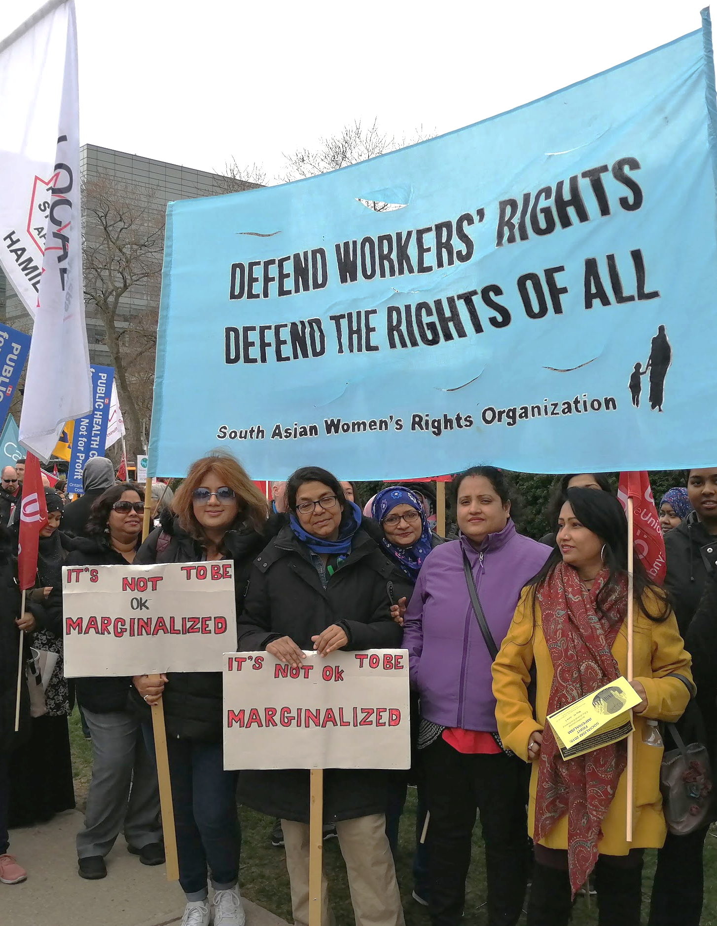
About SAWRO during COVID-19
Focused on making a contribution to the local, national and global effort for containment and mitigation of the pandemic
Re-organizing social service, cultural/social and advocacy program to address the pandemic crisis
Highest priority is facilitating community people’s compliance with the necessary protective measures

Slide 3
Consulting Precariously-employed Immigrant Women
Conducted over 1200 follow-up phone calls with community women and their families to provide information about livelihood support programs and encouraging community members to share their concerns and experiences during pandemic period.
Regularly convene online with community members, women leaders, and youth activists to talk about community member’s experience, needs, accessibility/adequacy of health and economic support programs

Slide 4
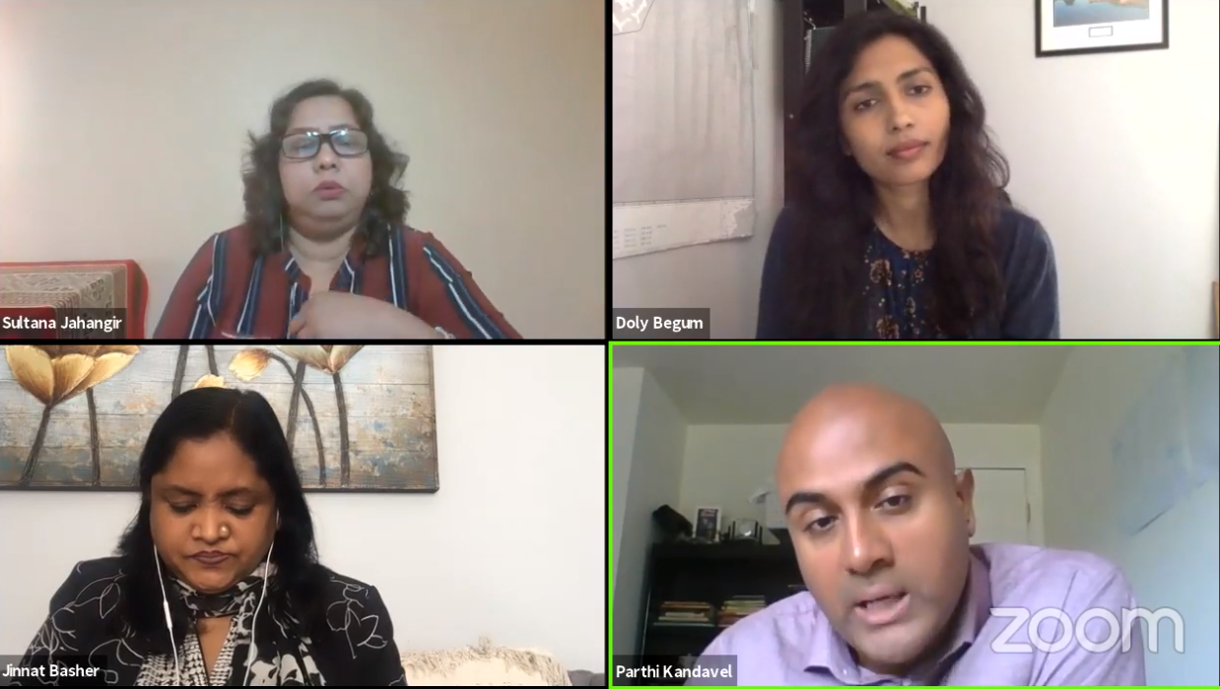
Interactive online community information and discussion sessions

Slide 5
Experience of precariously-employed Immigrant Women

Slide 6
Before the COVID-19 pandemic
High poverty and unemployment rates in the Oakridge and Taylor-Massey neigbourhoods
 | Poverty | Unemployment
Oakridge | 44% | 15%
Taylor Massey | 35% | 12%
(Toronto) | (20%) | (8%)
(City of Toronto 2016: Neighbourbood Improvement Area Index)

Slide 7
Before the COVID-19 pandemic
Normalization of underemployment and precarious employment of racialized immigrant women
Despite Bangladeshi immigrant women possessing high-levels of education, they face significant integration barriers and unique labour market barriers
They are pushed to the margins of the labour market in fast-food, retail services, and light manufacturing sectors where jobs are low-wage, insecure, and precarious in
The nature of these jobs exclude them from social and labour market supports (such as EI, CPP, Childcare subsidy, and more)

Slide 8
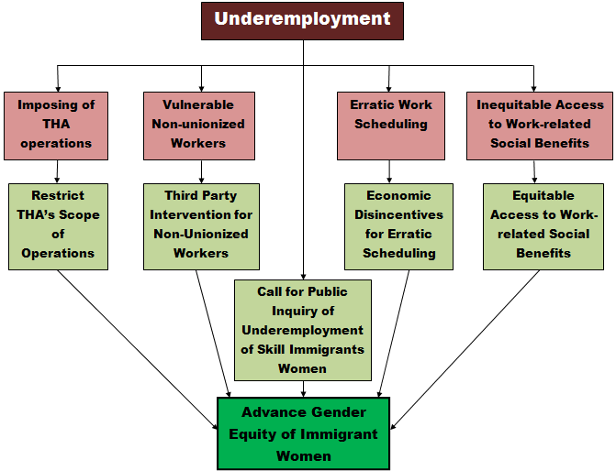
Our finding and recommendations Pre COVID 19

Slide 9
At the start of the COVID-19 pandemic
Most women were laid-off in December before the holidays and were not able to find work since
Mass layoffs of part-time and temporary workers, many women had to voluntarily leave work to take care of their children when schools closed
Those who continued to work face many challenges: childcare arrangements, unsafe work conditions, and intimidation from employers
Many community members, especially immigrant women, did not meet the criteria for regular work-related benefit (EI) and temporary pandemic economic supports (CERB and CESB)

Slide 10
During the COVID-19 pandemic
While relaxing on some criterias for economic support, they were still inaccessible to some immigrant women/seniors due to their vulnerable labour market situation and precarious immigration status
Ontario government’s list of ‘essential businesses’ was very expansive; workers in some retail, fast-food, and manufacturing settings (that did not produce essential items) had to return to work where there is high occupational risk for infection
Despite earning less than they would, they did not qualify for temporary economic supports
Notes:
Mention that immigrant women lacked access to economic supports before, during and after the COVID-19 pandemic.

Slide 11
StatsCan Labour Market Trends
Workers in retail, restaurant, manufacturing and other goods-producing sectors experienced greatest employment losses
Workers predominantly populating theses sectors are precariously employed immigrant women, youth and other new labour market entrants
Temporary jobs and employees earning less than $16.03/h experienced the greatest employment losses

Slide 12
StatsCan Labour Market Trends
“Vulnerable workers continue to see the greatest losses”
“Employment among low wage workers, particularly women, remains below pre-COVID levels”
Statistics Canada report shows that youth, women, and low wage workers (many of whom are racialized persons and immigrants) are being left behind in the "economic recovery" from the pandemic.

Slide 13
Increased economic insecurity among
community women
SAWRO Peer Workers conducted mass community-wide need assessment surveys by phone during April, May and June 2020
1,240 women were contacted about their employment status
839 (~70%) experienced jobs losses or reduced hours as a result of the COVID-19 pandemic
Outcome: the pandemic disproportionately impacted the employment status of women in the East Danforth community

Slide 14
Compounding of other social inequities
COVID-19 revealed and deepened the ‘cracks’ in our society
The vulnerable labour market positions and economic insecurity of immigrant women is compounded with other inequities:
Threats of losing current housing arrangement, which is already substandard and unaffordable
Increased health vulnerabilities and worsening health
Increase in domestic violence
Increased poverty

Slide 15
The need for Universal Economic and Health measures

Slide 16
IC/ES report on COVID-19 impacts
on Immigrants
“Although immigrants, refugees and other newcomers make up just over 25% of the Ontario population, they accounted for 43.5% of all COVID-19 cases”
“Socioeconomic factors are closely related to testing and positivity”
“The highest rates of positivity (in those tested and per capita) by world region were in immigrants and refugees where a majority were racialized in Canada (Central, Western and East Africa; South America; the Caribbean; South East Asia and South Asia) and who were more likely to live in a low-income neighbourhood”
Guttmann A, Gandhi S, Wanigaratne S, Lu H, Ferreira-Legere LE, Paul J, Gozdyra P, Campbell T, Chung H, Fung K, Chen B, Kwong JC, Rosella L, Shah BR, Saunders N, Paterson JM, Bronskill SE, Azimaee M, Vermeulen MJ, Schull MJ. COVID-19 in Immigrants, Refugees and Other Newcomers in Ontario: Characteristics of Those Tested and Those Confirmed Positive, as of June 13, 2020. Toronto, ON: ICES; 2020.

Slide 17
About the ‘transition’ period
Federal government announced several changes to Employment Insurance and announced new recovery benefits that are expected to include many of those who would otherwise be excluded
Need to see continued trend in increasing access to traditional economic and social support programs, even after the crisis period

Slide 18
Universal Health and Economic
measures are required
Government must provide livelihood support payments universally available to all working people, regardless of their labour market position
Fix Employment insurance and other programs!
Increase government protections for vulnerable workers
Precariously-employed immigrant women need to be part of the local, provincial, and national discussions in all areas

